Slide 1
Two-Phase Locking Techniques for Concurrency Control
Dealing with Deadlock and Starvation
Deadlock:
Occurs when each transaction T in a set of two or more transactions is waiting for some item that is locked by some other transaction T′ in the set.
Each transaction in the set is in a waiting queue, waiting for one of the other transactions in the set to release the lock on an item.

Slide 2
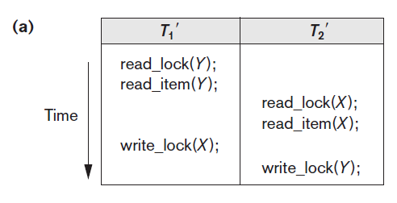
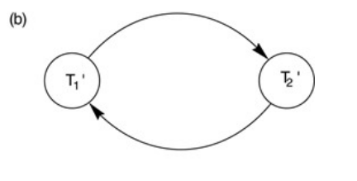
Two-Phase Locking Techniques for Concurrency Control
Dealing with Deadlock and Starvation
T1′ is in the waiting queue for X, which is locked by T2′, whereas T2′ is in the waiting queue for Y, which is locked by T1′.
Meanwhile, neither T1′ nor T2′ nor any other transaction can access items X and Y.

Slide 3
Two-Phase Locking Techniques for Concurrency Control
Dealing with Deadlock and Starvation
There are two approaches:
Deadlock prevention
Mostly used for real time systems
Where delays because of deadlocks are not appreciated
Deadlock detection & recovery
Used the chances of deadlock occurrence is minimum,
Its more likely a reactive approach in case of deadlock occurrence

Slide 4
2PL Techniques for Concurrency Control
Dealing with Deadlock and Starvation
Deadlock Prevention Protocols.
One deadlock prevention protocol,
which is used in conservative two-phase locking, requires that every transaction lock all the items it needs in advance —if any of the items cannot be obtained, none of the items are locked.
Obviously, this solution further limits concurrency.
A second protocol,
involves ordering all the items in the database and making sure that a transaction that needs several items will lock them according to that order.
This also limits concurrency
The third one is transaction timestamp TS(T′)
which is a unique identifier assigned to each transaction.
The timestamps are based on the order in which transactions are started; if transaction T1 starts before transaction T2, then TS(T1) < TS(T2).

Slide 5
Two-Phase Locking Techniques for Concurrency Control
Dealing with Deadlock and Starvation
Deadlock Prevention Protocols.
Two schemes that uses timestamps to prevent deadlock are:
wait-die
wound-wait.

Slide 6
Two-Phase Locking Techniques for Concurrency Control
Dealing with Deadlock and Starvation
Deadlock Prevention Protocols.
Wait-die:
If (TS(Ti) < TS(Tj)),
then wait(T_{i});
Else,
Die(T_{i})
and restart it later with the same timestamp.
Younger transactions never wait for older ones; they are rolled back instead.
A transaction may die several times before acquiring needed data item

Slide 7
Two-Phase Locking Techniques for Concurrency Control
Dealing with Deadlock and Starvation
Deadlock Prevention Protocols.
Wound-wait:
If (TS(Ti) < TS(Tj)),
abort Tj (Ti wounds Tj)
and restart it later with the same timestamp;
Else
Ti is allowed to wait.
Older transaction wounds (forces rollback) of younger transaction instead of waiting for it.
Younger transactions may wait for older ones.
May be fewer rollbacks than wait-die scheme.

Slide 8
Two-Phase Locking Techniques for Concurrency Control
Dealing with Deadlock and Starvation
Deadlock Prevention Protocols.
Both schemes end up aborting the younger of the two transactions that may be involved in a deadlock.
Both techniques may cause some transactions to be aborted and restarted needlessly, even though those transactions may never actually cause a deadlock.

Slide 9
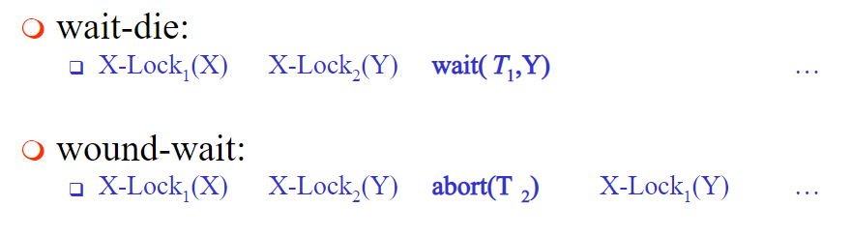
Two-Phase Locking Techniques for Concurrency Control
Dealing with Deadlock and Starvation
Deadlock Prevention Protocols.
T₁ (TS=10) | T₂ (TS=20)
W(X)
 | W(Y)
W(Y)
 | W(X)

Slide 10
Two-Phase Locking Techniques for Concurrency Control
Dealing with Deadlock and Starvation
Deadlock Prevention Protocols.
Another set of protocols that prevent deadlock without using timestamps are:
No waiting
Cautious waiting

Slide 11
Two-Phase Locking Techniques for Concurrency Control
Dealing with Deadlock and Starvation
Deadlock Prevention Protocols.
No waiting Algorithm
if a transaction is unable to obtain a lock,
it is immediately aborted and then restarted after a certain time delay without checking whether a deadlock will occur or not.
No transaction ever waits, so no deadlock will occur.
Problem:
A transaction will repeatedly be aborted and restarted

Slide 12
Two-Phase Locking Techniques for Concurrency Control
Dealing with Deadlock and Starvation
Deadlock Prevention Protocols.
Cautious waiting algorithm:
This algo is Proposed to reduce the number of needless aborts/restarts.
Transaction Ti tries to lock an item X
but is not able to do so because,
X is locked by some other transaction Tj with a conflicting lock.
Cautious waiting rule is :
If Tj is not blocked (not waiting for some other locked item),
then Ti is blocked
and allowed to wait;
otherwise
abort Ti.

Slide 13
Two-Phase Locking Techniques for Concurrency Control
Dealing with Deadlock and Starvation
Deadlock Prevention Protocols.
Cautious waiting algorithm:
Advantage:
No transaction is ever waiting for a blocked transaction
Hence, Deadlock free

Slide 14
Two-Phase Locking Techniques for Concurrency Control
Dealing with Deadlock and Starvation
Deadlock Prevention Protocols.
Deadlock Detection:
The system checks if a state of deadlock actually exists.
We can use this scheme :
If we know that different transactions will rarely access the same items at the same time.
if the transactions are short and each transaction locks only a few items.

Slide 15
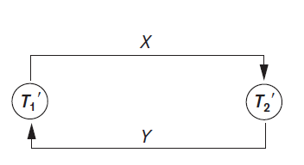
Two-Phase Locking Techniques for Concurrency Control
Dealing with Deadlock and Starvation
Deadlock Prevention Protocols.
Way to detect a state of deadlock is for the system to construct and maintain a wait-for graph.

Slide 16
Two-Phase Locking Techniques for Concurrency Control
Dealing with Deadlock and Starvation
Deadlock Prevention Protocols.
How to create a wait-for graph
One node is created in the wait-for graph for each transaction that is currently executing.
Whenever a transaction Ti is waiting to lock an item X that is currently locked by a transaction Tj,
a directed edge (Ti → Tj) is created
When Tj releases the lock(s) on the items that Ti was waiting for,
the (Ti → Tj) is dropped from the wait-for graph.
We have a state of deadlock if and only if the wait-for graph has a cycle.
When to Check for a cycle:
every time an edge is added to the wait for graph,
but this may cause excessive overhead.

Slide 17
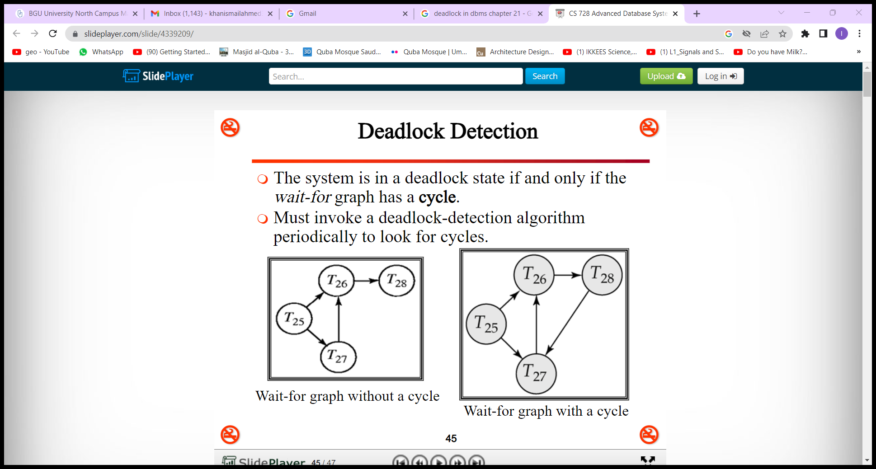
Two-Phase Locking Techniques for Concurrency Control
Dealing with Deadlock and Starvation
Deadlock Prevention Protocols.
wait-for graph.

Slide 18
Two-Phase Locking Techniques for Concurrency Control
Dealing with Deadlock and Starvation
Deadlock Prevention Protocols.
If the system is in a state of deadlock,
some of the transactions causing the deadlock must be aborted.
Choosing which transactions to abort is known as victim selection.
The algorithm for victim selection should:
avoid;
selecting transactions that have been running for a long time
and that have performed many updates, (older transactions)
Select;
transactions that have not made many changes (younger transactions).

Slide 19
Two-Phase Locking Techniques for Concurrency Control
Dealing with Deadlock and Starvation
Timeouts.
Another way to Deal with deadlock is the use of timeouts.
How it works?
If a transaction waits for a period > the system-defined timeout period,
the system assumes that the transaction may be deadlocked
and aborts it regardless of whether a deadlock actually exists.
Advantage:
Practical approach as Low overhead and simple

Slide 20
Two-Phase Locking Techniques for Concurrency Control
Dealing with Deadlock and Starvation
Starvation.
Problem that may occur when we use locking is starvation,
which occurs when a transaction cannot proceed for an indefinite period
while other transactions in the system continue normally.

Slide 21
Two-Phase Locking Techniques for Concurrency Control
Dealing with Deadlock and Starvation
Starvation.
Why it occurs?
The waiting scheme for locked items is unfair in that it gives priority to some transactions over others.
Starvation can also occur because of victim selection if the algorithm selects the same transaction as victim repeatedly, thus causing it to abort and never finish execution.
Solutions:
One solution for starvation is to have a fair waiting scheme, such as using a first-come-first-served queue.
Another scheme allows some transactions to have priority over others but increases the priority of a transaction the longer it waits, until it eventually gets the highest priority.

